Slide 1
Predicting Movie Recommendations by Leveraging Deep Learning and MovieLens Data
Brown University-Data 2040
April 19th, 2021
Blog #1: https://bit.ly/3dulh1P
Blog #2: https://bit.ly/3efuERZ
Blog #3: https://bit.ly/2QBRYBy
Annie Phan
Drew Solomon
Roma Coffin
Yuyang Li

Slide 2
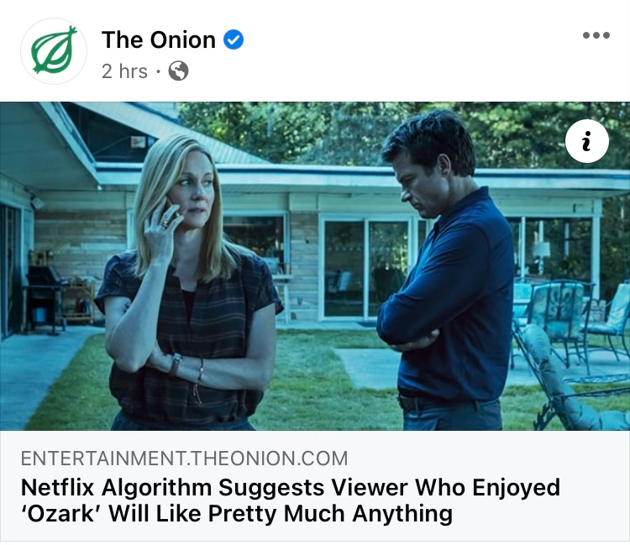
Agenda
Introduction
About Project & Summary
EDA
Baseline Results
Transformer Model
Autoencoder
Word2Vec
Takeaways & Next Steps
Notes:
First I Roma Coffin, will be providing, a brief overview and summary of the project
And will give information about setup of the project,
After I will discuss EDA, and
Then Mike and Annie will discuss baseline results and some improvements on the same vanilla embedding baseline
After, Drew will take over by discussing the transformer model
Annie will give an overview of the autoencoder
And Mike will provide details on word2vec
Lastly, I will finish by going over takeaways & next steps.

Slide 3



About Project & Summary
Leverage Movielens dataset and deep learning in recommendation systems to predict movie recommendations
Visualize data through EDA to help familiarize us with the datasets used (Movie, Ratings, and Users) and capture common data patterns
Improve upon an existing state of the art model by James Le by achieving a better RMSE to more accurately provide a user with personalized content f
Notes:
1-Our goal was to leverage MovieLens Data and deep learning to predict movie recommendations. We wanted to build of the theme of more accurately providing personalized content for the modern consumer.
2-Additionally we have visualized data through EDA to help familiarize us with the three datasets used (Movies, Ratings, and Users) and to capture common data patterns
3. Our main objective was to incorporate deep learning models into recommendation systems to build a model that replicated a previously created model and improved upon it and also found new applications. We used research by James Le because his approach is clear, transparent, applicable, and achieves quality results.

Slide 4
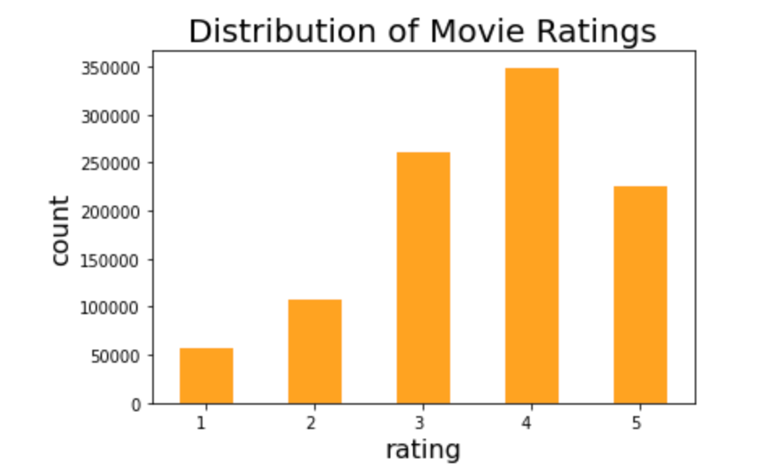
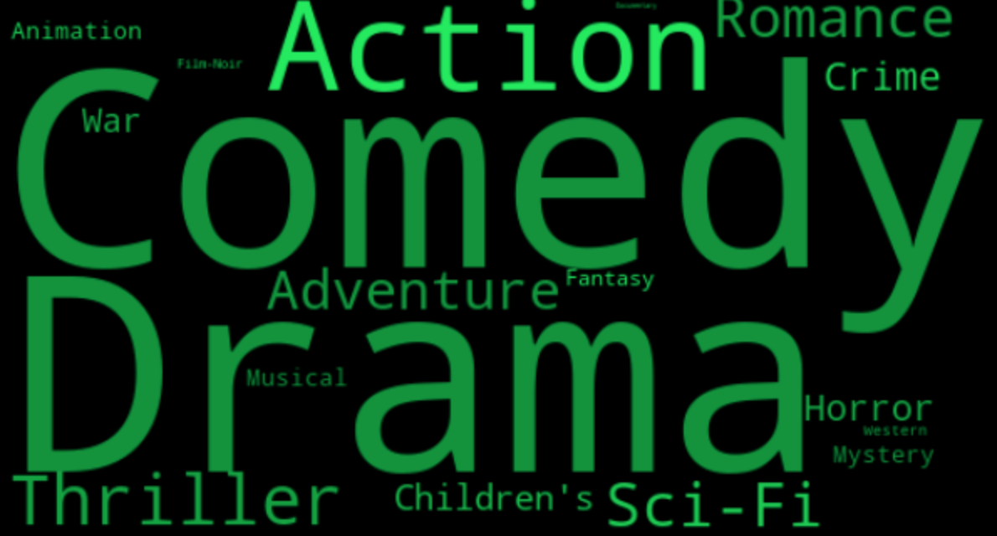
EDA
For us to better understand the dataset, exploratory data analysis (EDA) was performed
To get a sense of the distribution of movie ratings a bar chart was made to reveal that the ratings are skewed to left and have a mode of 4.
WordCloud visualization showed the most prevalent genres (comedy and drama) and the effect. This provides a better idea of potential biases in the training set so we can eliminate them during our model constructing stage.
Notes:
EDA helped to familiarize us with the dataset by capturing common data patterns and to help us with data visualization.
To get a sense of the distribution of ratings in the dataset we made a bar chart which reveals the dataset is skewed to the left, slightly imbalanced, and the rating 4 was the most dominant. This is important to know so in the future we may potentially stratify to ensure all of the ratings are adequately represented across training, validation, and testing datasets.
After checking the ratings, we decided to build a Wordcloud visualization to see the most prevalent genre. Genre output was edited because there were 301 different categories. Since, some movies had multiple genres (ex. romantic comedy would count as romance and comedy) they were counted as each genre separately. We can see that comedy and drama are the most present genres.This gives us a better idea of what potential bias we might have in the training set. Therefore, we can try to eliminate the bias during our model constructing stage.

Slide 5
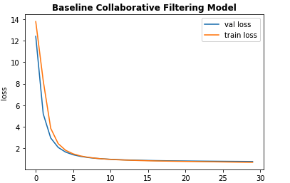
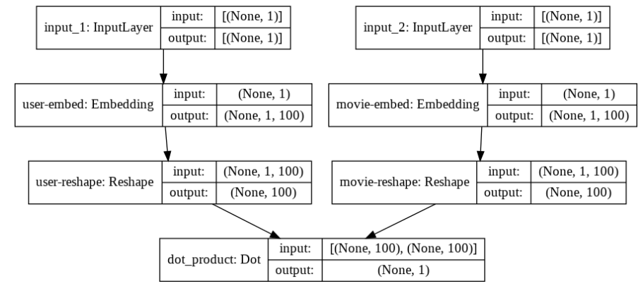
Baseline Model: Vanilla Embedding
Our baseline model achieved a minimum RMSE at epoch 30 of 0.877, so the leading validation loss was 0.763.

Slide 6
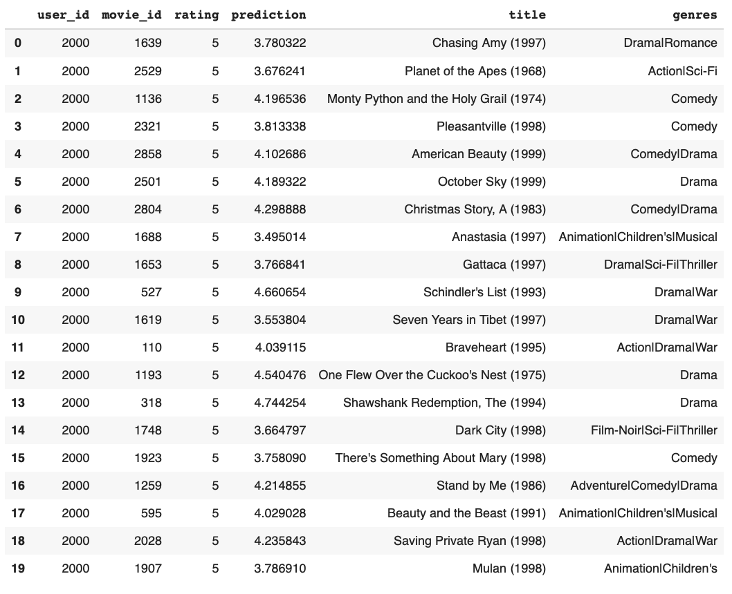
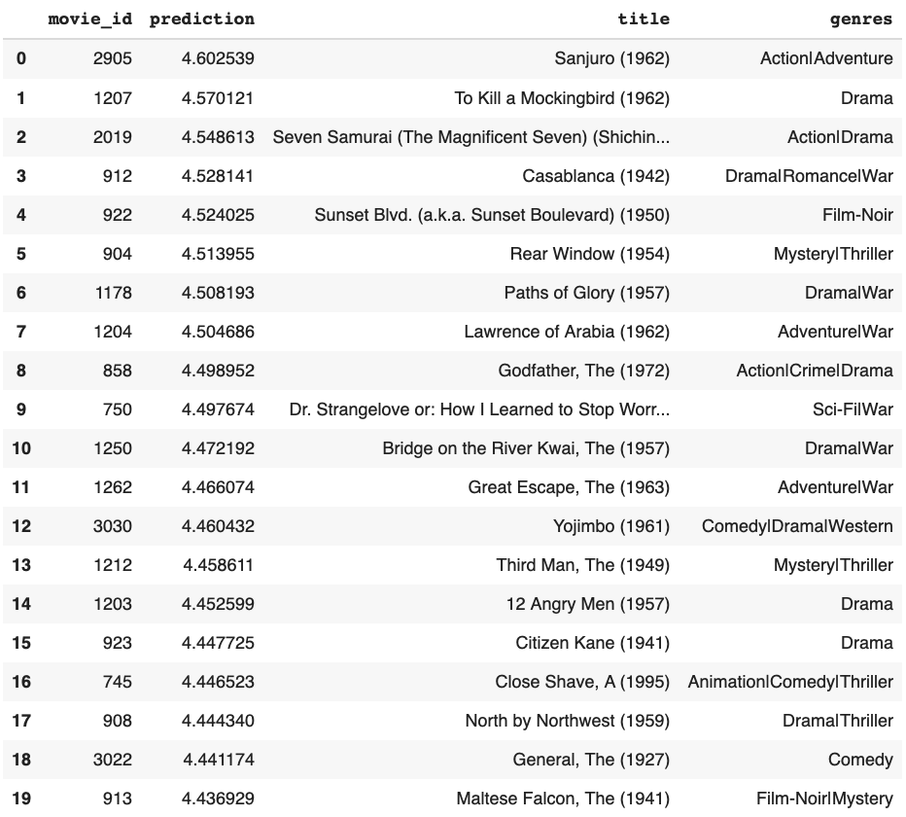
Baseline Model: Vanilla Embedding
Using baseline model we generated movie rating recommendations and recommendations of unrated movies based on prediction ratings
Movie Ratings Prediction of User with ID = 2000
Recommended Movies for User with ID = 2000 based on Predicted Ratings
Notes:
We also include the recommendations from the baseline model that we based our model off of and 20 recommendations of unrated movies sorted by prediction value when the user_id =2000

Slide 7
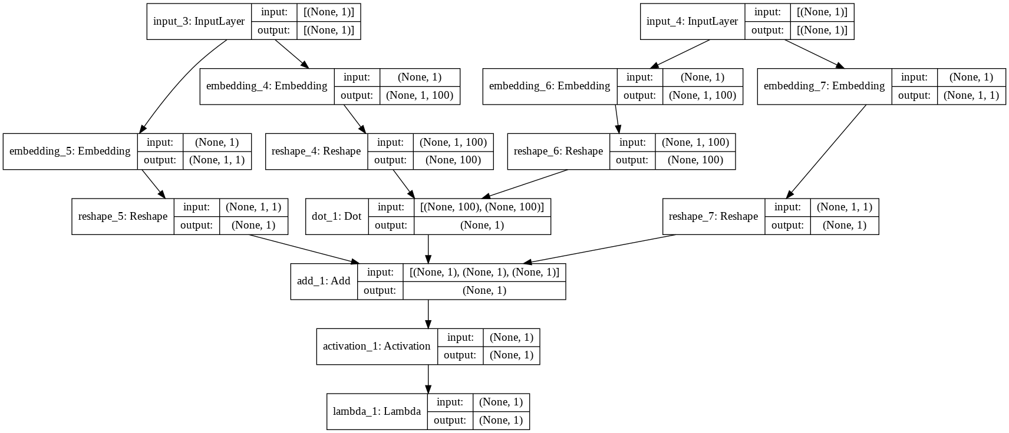
Tuned Baseline Model
Model Structure
Notes:
We made changes to the baseline model by running the output of the dot product through a sigmoid layer and then scaling the result using minimum and maximum ratings of the data to introduce non-linearity. Additionally, we pulled the embedded layer and reshaped operations into a separate class.

Slide 8
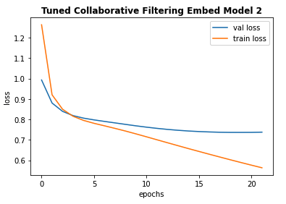
Tuned Baseline Model
Our tuned baseline model achieved a minimum RMSE at epoch 20 of 0.858.
Notes:
We achieved a minimum RMSE at epoch 20 of 0.8583. This time we saw an improvement in RMSE of around 0.03, compared to our baseline model

Slide 9
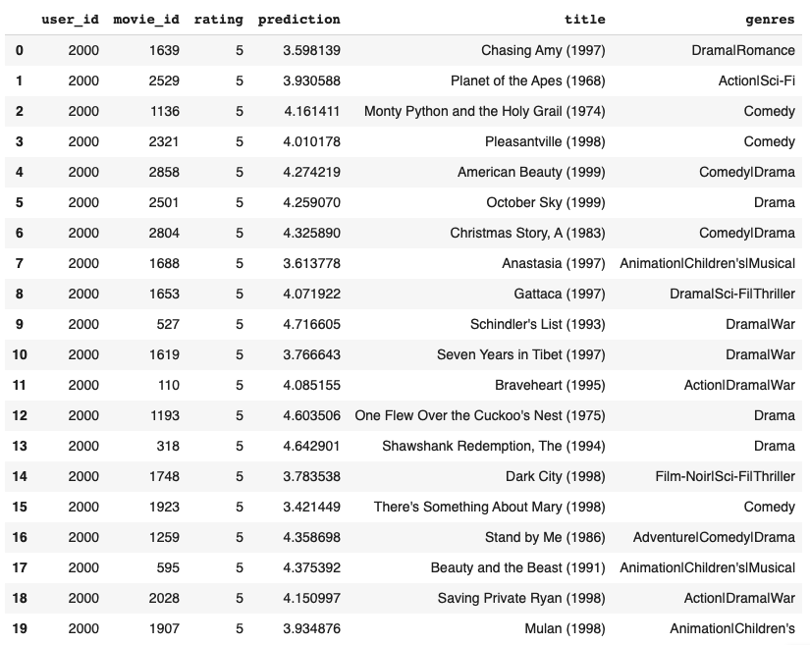
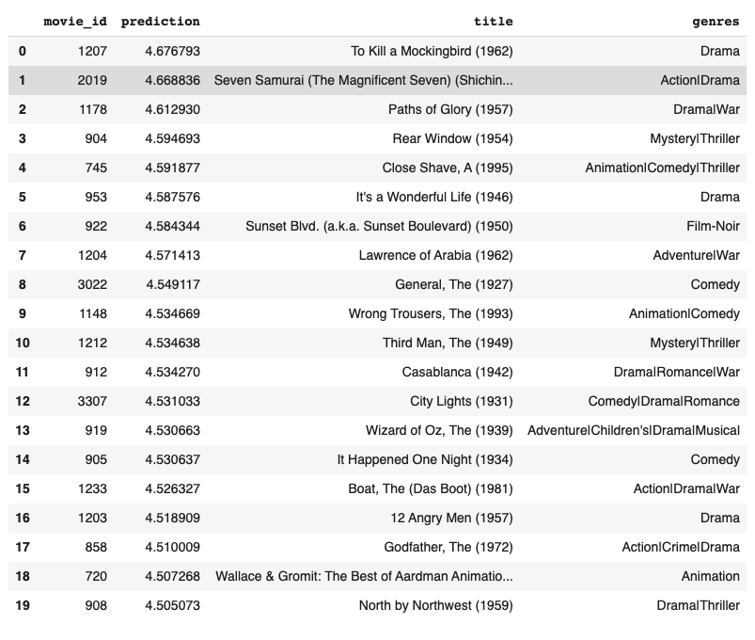
Tuned Baseline Model
Using tuned baseline model we generated movie rating recommendations and recommendations of unrated movies based on prediction ratings
Movie Ratings Prediction of User with ID = 2000
Recommended Movies for User with ID = 2000 based on Predicted Ratings
Notes:
We also include the recommendations from the tuned baseline model that we based our model off of and 20 recommendations of unrated movies sorted by prediction value when the user_id =2000

Slide 10
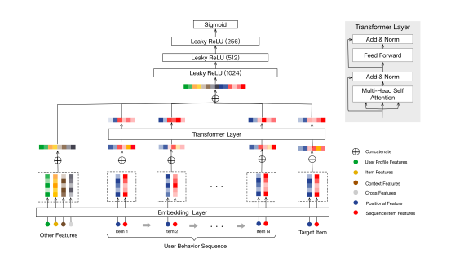
Transformer Model - Sequential behavior
Encoder-decoder architecture
Attention only (no CNN/RNN)
Processes in parallel
Short & long range dependencies
Behavior Sequence Transformer model architecture, Qiwei Chen et al. (2019)

Slide 11
Transformer Model - Steps
Goal: Predict the rating of target movies using users’ past movie viewing/rating history (and user demographics + movie genres)
Process overview:
Process data into dataframe of users (1 per row), each with a list of movies and list of ratings
Split each list of movies and ratings into sequences (of length 4) for training/predictions
Split data into train, val, and test datasets (80/10/10)
Split sequences into features and target
Create model inputs layers
Encode input features -> embeddings
Create BST model (with multi-head attention inside transformer blocks + our parameters)
Train model on training data
Evaluate model on test data

Slide 12
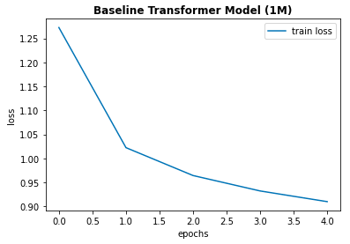
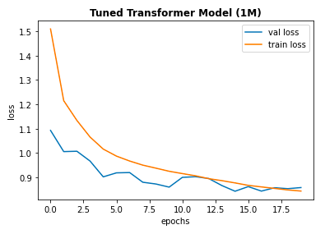
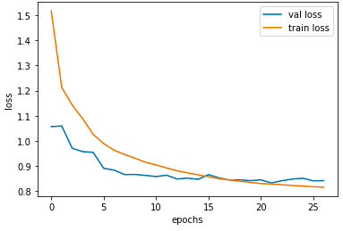
Transformer Model - 1M ratings
Train Epoch vs Loss Graph for Baseline Transformer
RMSE: 0.961
Train Epoch vs Loss Graph for Tuned Transformer
RMSE: 0.920
1 transformer block, 3 attention heads
2 FC layer with 255 & 128 neurons
drop-out = 0.1, learning rate = 0.01, Adagrad
2 transformer blocks, 8 attention heads each
1 FC layer with 128 neurons
drop-out = 0.5, learning rate = 0.02, Adagrad
Notes:
For our baseline model, we got an RMSE of 0.961. From this model, we added more input features into the encoder, and tuned the available hyperparameters. For example, encoded features such as user’s occupation, gender, zip code and genre of movie. With this, our tuned transformer model may attend to richer information in capturing sequential signals underlying users’ behavior. We integrated early stopping based on validation loss. Additionally, we tuned parameters such as number of attention heads, number of transformer blocks, number of hidden neurons in dense layers, number of dense layers, dropout rate, learning rate, and batch size. Through this, we achieved a minimum RMSE at epoch 26 of 0.920, on the 1 million ratings data.

Slide 13
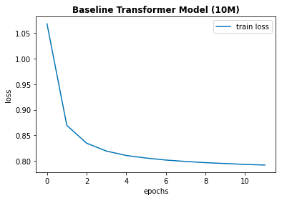
Transformer Model- 10M ratings baseline
Our tuned baseline model achieved a minimum RMSE at epoch 11 of 0.876.
MovieLens, 10 million ratings
~ 70’000 users
~ 10’000 movie
No user demographics
Train Epoch vs Loss Graph for Baseline Transformer

Slide 14
Transformer Model - 10M Results
BST Results Summary (10M)
Model (10M Dataset) | FC Layer Units | Dropout Rate | Attention Heads | Transf. Blocks | Learning Rate | Batch Size | RMSE
Baseline BST | [256, 128] | 0.1 | 3 | 1 | 0.01 | 256 | 0.876
Tuned BST1 | [128] | 0.1 | 8 | 2 | 0.01 | 512 | 0.905
Tuned BST2 | [128] | 0.5 | 8 | 2 | 0.02 | 512 | 0.918
Tuned BST3 | [256, 128] | 0.4 | 10 | 3 | 0.02 | 512 | 0.889
Tuned BST4 | [256, 128] | 0.4 | 3 | 2 | 0.02 | 256 | 0.879
Tuned BST5* | [256, 128] | 0.3 | 8 | 2 | 0.02 | 256 | 0.863
Tuned BST6** | [256, 128] | 0.3 | 8 | 2 | 0.02 | 256 | 0.860
*Tuned BST 5 Also extended sequence length from 4 to 6
**Tuned BST 6 Kept sequence length 6 and added user ID and movie feature input embeddings
Notes:
To better capture the behaviors of the users in the MovieLens datasets a behavioral sequence transformer was implemented. Transformers - network architectures based on attention mechanisms - can help leverage consumers’ past behavior to tailor recommendations to them. Since transformers don’t need to process data in order, they help a lot with efficiency as training time significantly decreases.

Slide 15
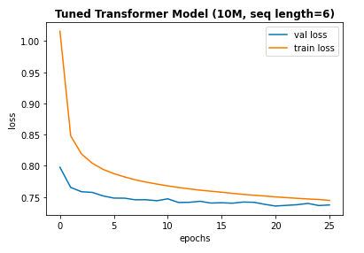
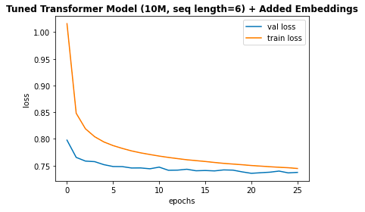
Transformer Model-BST 5 & 6
Impact of added embeddings on best BST models
BST 5 (RMSE 0.863)
BST 6 (RMSE 0.860)
Train and Validation Epoch vs Loss Graph for BST 5
Train and Validation Epoch vs Loss Graph for BST 6
Notes:
Added movie feature embeddings (genre) and user ID embeddings into encoder

Slide 16
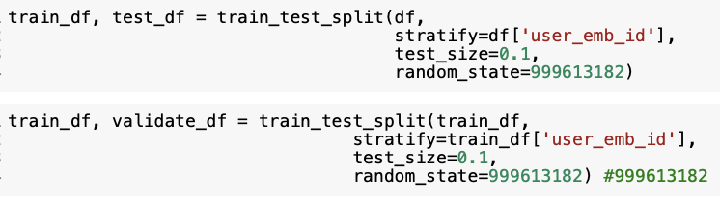
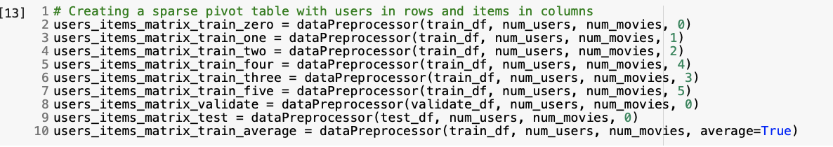
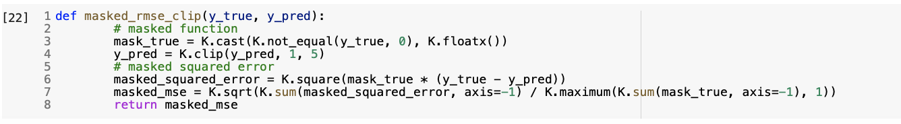
Autoencoder: Overview and Set Up
Autoencoders are a type of neural networks that learns a representation by reducing data dimensions and training a network to ignore the noise in the data
split the data into approximately 80% of the data being assigned to the train sets, 10% to the validation set, and 10% of the data to the test set.
stratified the data by user_id to ensure that we have similar class balances across the different sets
transform the data in these different sets into the user-item rating matrix → matrix has the shape 6040 x 3952 (6040 unique users and 3952 unique movies)
have many default ratings for unobserved ratings, which can take values from 0 to 5 → different values for the default ratings can result in different RMSE scores.
customized loss functions to calculate the masked RMSE and loss (masked MSE): it is crucial that the model only considers non-zero rating during inference because it simply doesn’t make sense to count ratings that are 0

Slide 17
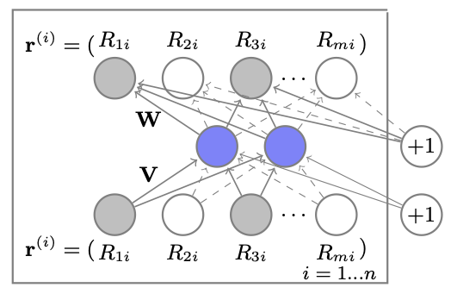
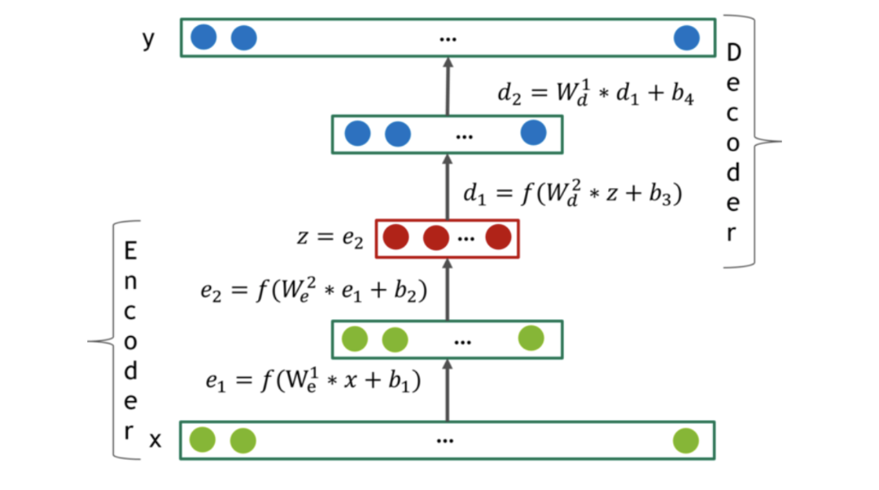
Autoencoder: Methodology
Implemented 2 key model structures:
AutoRec: the model proposed in the “AutoRec: Autoencoders Meet Collaborative Filtering” paper
Deep AutoRec (Deep AE): a deep learning implementation of AutoRec, consists of more hidden layers, regularization, activation functions
Hyperparameters tuned:
number of layers, number of neurons in each layer, and different activation function
regularization lambda, drop out rate, and learning rate
Other methods tried
Train the models on different training matrices with different default rating values
Load in the MovieLens 10M dataset → RAM of our Google Colab Pro could not handle the computation to transform this dataset into the user-item matrix
Add noise (Gaussian and DropOut noise)
Add more predictive features: gender, age, occupation
Train the model on a specific demographic subset and predict for a user in that subset (“demographic-based recommender system”)
AutoRec Structure (from the paper “AutoRec: Autoencoders Meet Collaborative Filtering” by Sedhain in 2015
Deep AutoRec (from the paper Introduction To Recommendation Systems With Deep Autoencoders” by González-Fierro 2018)

Slide 18
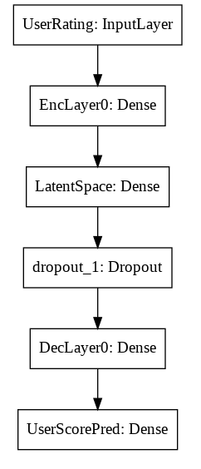
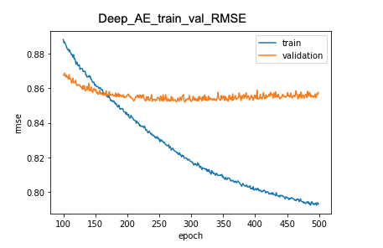
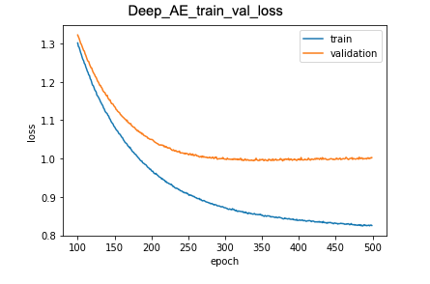
Autoencoder: Best Model - Deep AutoRec Performance and Results
We achieved a masked RMSE of 0.858 and loss of 0.996. This is a 0.019 improvement from our vanilla embedding’s baseline RMSE of 0.877
DeepAutoRec
Training user-item matrix has default ratings = 0
Number of users = 6040
Number of movies = 3952
Layers = [256, 512, 256]
Dropout rate = 0.8 Activation and last_activation = 'selu’
Regularization alpha of encoder and decoder = 0.001
Deep AutoRec Model Structure
Train and Validation Epoch vs RMSE Graph for Deep AutoRec
Train and Validation Epoch vs Loss Graph for Deep AutoRec

Slide 19
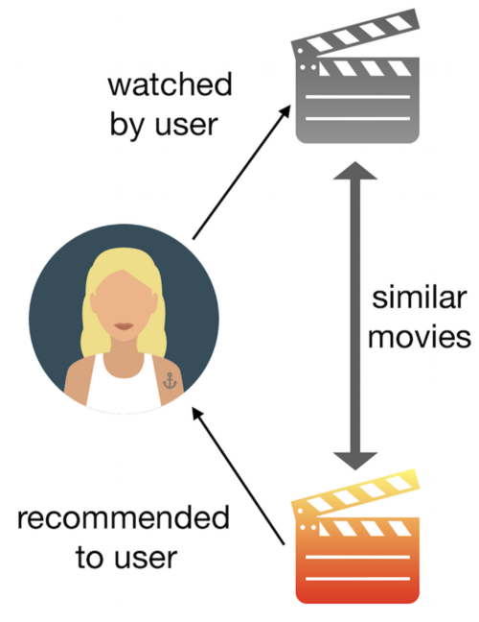
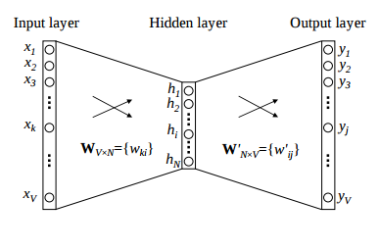
Word2Vec
Word2vec models input movies and translate them into vectors, and then train on these movie embedding vectors
Word2Vec Content Based Filtering Concept (from Grimaldi 2018)
Word2Vec Model Architecture (from Karani, 2018)
Notes:
Content-based filtering is based on the idea that users who previously had similar taste will also have in the future. Word2Vec is a neural network model which learns word embeddings from large datasets. We implemented a Word2Vec content-based filtering model for this task to recommend movies based on users’ previous preferences.

Slide 20
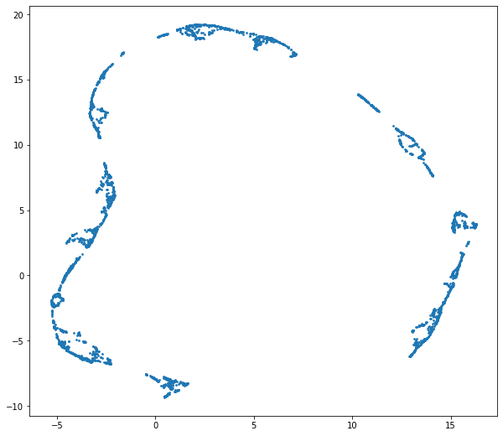
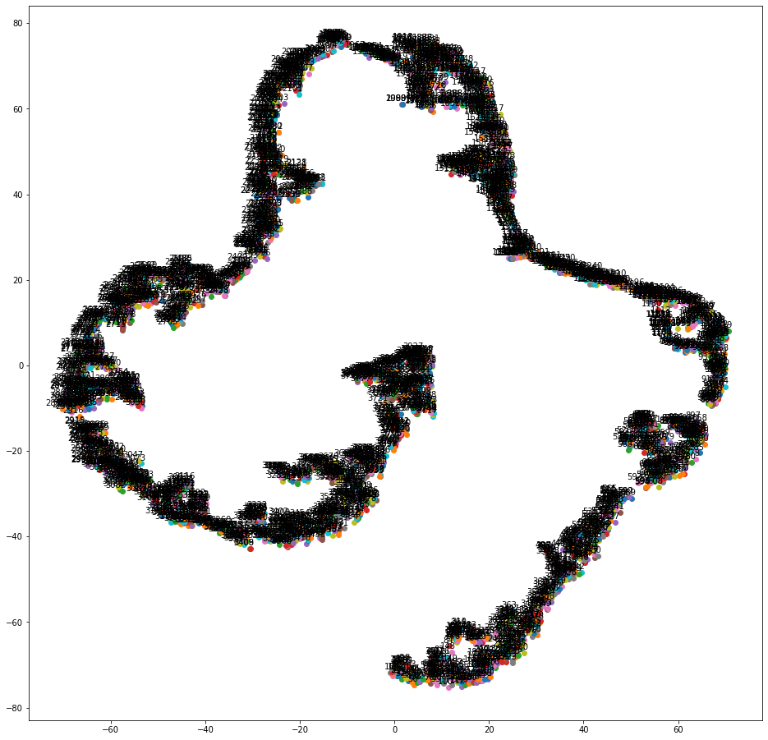
Word2Vec
To appropriately visualize word2vec embeddings, tsne and umap are leveraged for dimension reduction
Visualize word2vec embeddings by reducing dimensions using UMAP
Visualize word2vec embeddings by reducing dimensions using t-SNE
Notes:
To better understand the data we generated visualizations of word2vec embeddings by reducing dimensions using t-SNE and UMAP. Since we cannot visualize these embeddings directly as the output was vectors of size 100, t-SNE and UMAP were leveraged to visualize these embeddings.

Slide 21
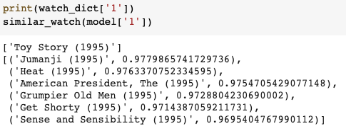
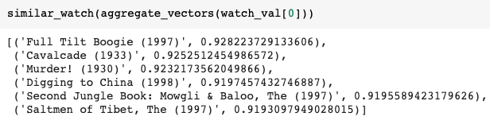
Word2Vec
Recommendation Outputs
Get recommendations outputs Word2Vec Model
Notes:
Lastly, we generated two functions. One takes a movie as an input and returns the top 6 similar movies. And the other one takes the average of all the vectors and returns the top 6 similar movies.
probability of being the nearby word for every word in the vocabulary on average for top 6 movies recommended = 0.97 (using a movie’s vector as input)
probability of being the nearby word for every word in the vocabulary on average for top 6 movies recommended = 0.92 (using average of all the vectors of movie that user watches as input)

Slide 22
Takeaways and Next Steps
Application | Recommendation Method | Parameters and Configurations of Best Model | Result(s) of Best Model
Vanilla Embedding | Collaborative Filtering | Number of users = 6040 Number of movies = 3952 Number of dimensional embeddings for movies and users = 100 | RMSE = 0.877
Behavioral Sequence Transformer | Collaborative Filtering | FC Layer Units = [256, 128] Dropout Rate = 0.3 Attention Heads = 8 Transformation Blocks = 2 Learning Rate = 0.02 Batch Size = 256 | RMSE = 0.860
Deep AutoEncoders | Collaborative Filtering | Deep AE model Training user-item matrix has default ratings = 0 Number of users = 6040 Number of movies = 3952 Layers = [256, 512, 256] Dropout rate = 0.8 Activation and last_activation = 'selu’ Regularization alpha of encoder and decoder = 0.001 | Masked RMSE (RMSE only for non-zero ratings) = 0.858
Word2Vec | Content Filtering | Window = 8, Sg = 1, Hs = 0 Negative = 15, Alpha = 0.001 Min_alpha = 0.0001, Seed = 34 Progress_per = 250, Epochs = 20, Report_delay = 1 | Probability of being the nearby word for every word in the vocabulary on average for top 6 movies recommended = 0.97 (using a movie’s vector as input) Probability of being the nearby word for every word in the vocabulary on average for top 6 movies recommended = 0.92 (using average of all the vectors of movie that user watches as input)
Notes:
This table compares the vanilla embedding model to the best models for each of our different applications.
We were able to achieve an RMSE of

Slide 23
Takeaways and Next Steps
While there is always room for improvement, we are pleased with our progress towards generating movie recommendations, and our (deep) learning along the way
Performance could have been boosted by being able to use the larger movielens dataset such as the 10M and 20M movielens datasets (only able to use 10m for Transformer)
Implement decoder in transformer model to generate movie titles from predictive ratings
Look more into the demographic-based approach for Auto encoders although it was not the best performing model, showed a lot of promising results
Word2Vec content-based filtering performs recommendation tasks well, thus looking into Word2Vec collaborative filtering in the future would be a good idea
Notes:
We believe there are a few main changes and updates we could make to the model, provided we had more time.
Performance could have been boosted by being able to use the larger movielens dataset such as the 10M and 20M movielens datasets (only able to use 10m for Transformer)
Implement decoder in transformer model to generate movie titles from predictive ratings
Look more into the demographic-based approach for Auto encoders although it was not the best performing model, showed a lot of promising results
It turns out that Word2Vec content-based filtering works well under this context. And based on this we might want to try Word2Vec collaborative filtering in the future.

Slide 24
Thank you everyone for a great semester!

Slide 25
References:
Mike:
https://towardsdatascience.com/how-to-build-from-scratch-a-content-based-movie-recommender-with-natural-language-processing-25ad400eb243
https://towardsdatascience.com/introduction-to-word-embedding-and-word2vec-652d0c2060fa

